Slide 1




The Social Work (Scotland) Act 1968
Professor Viviene Cree
Email viv.cree@ed.ac.uk
@VivCree
20th March 2018
www.socialwork.ed.ac.uk/centenary

Slide 2
Today’s session
An overview of the 1968 Act, its policy intentions, key strengths & impact
The opportunities and challenges looking forward
But first – the 1960s …
www.socialwork.ed.ac.uk/centenary

Slide 3
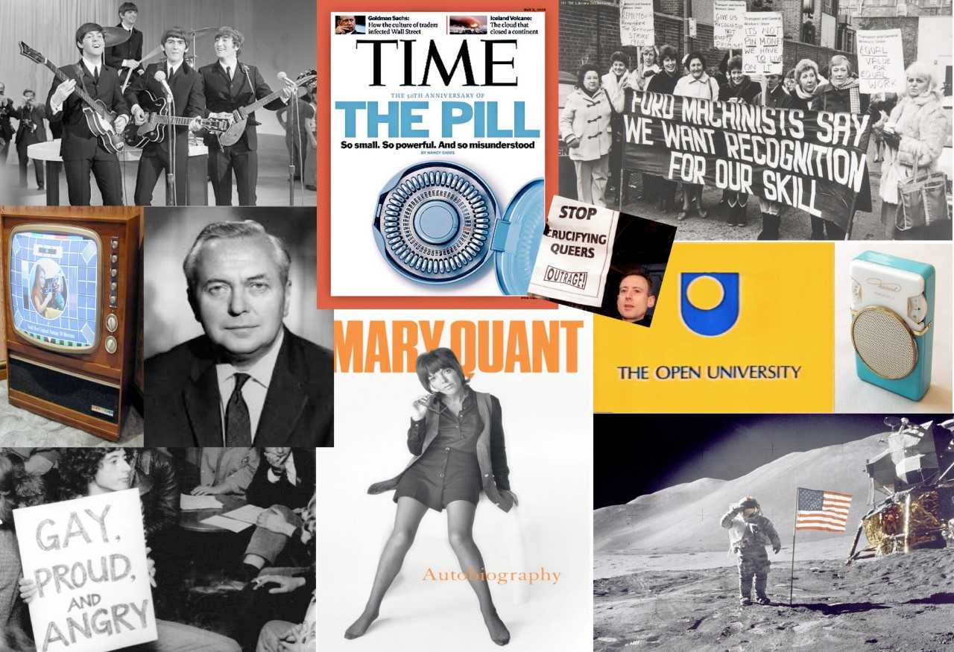
The swinging 60s – a time of social change?
www.socialwork.ed.ac.uk/centenary

Slide 4
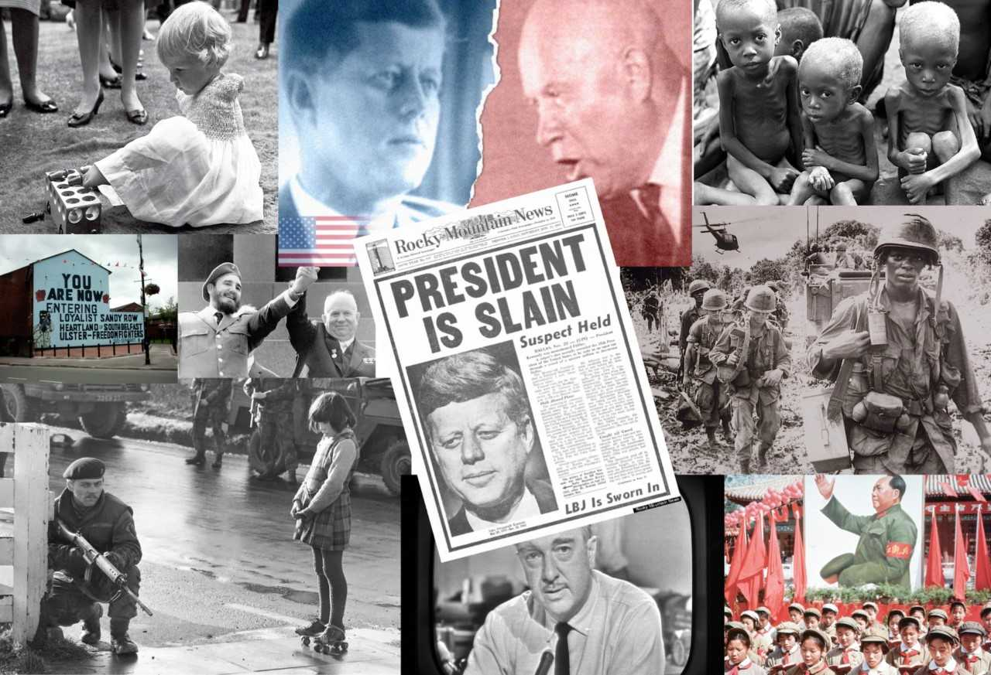
But not everything in the garden was rosy …
www.socialwork.ed.ac.uk/centenary

Slide 5
Policy intentions
To solve the problem of disparate and uneven social work services – to simplify & clarify by creating “a single door on which anyone might knock to ask for help” (1966 p.4)
To solve the problem of what to do with children – children who offend and children in need – because their situations were found to be much the same
What made this possible was a shared belief that social work could make a difference: government, professional bodies, social workers & academics came together to take this forward with “the community”
www.socialwork.ed.ac.uk/centenary

Slide 6
The Act itself – main provisions
A universal, comprehensive SOCIAL WORK service, managed by Directors of Social Work
A reformed system of juvenile justice – children’s panels
Section 12: duty on local authorities (LAs) to “promote social welfare … ”
The Act provided much of the framework for the activities of LA social workers, and set down specific duties and procedures to be followed in particular circumstances.
More than 50% of the Act set down processes relating to children & families & children’s panels – but section 12 applied to all citizens, including older people, those with disabilities and mental health problems
www.socialwork.ed.ac.uk/centenary

Slide 7
So what happened??
“The Act was one thing, its realisation another”
(Murphy 1992 p. 182)
www.socialwork.ed.ac.uk/centenary

Slide 8
Immediate challenges
Even before the Act came into force in 1971, the working party’s report stated that it “represents an aspiration and a target, rather than an immediate increase in resources” (1969 p.3)
Shortage of trained and experienced staff – in 1968, there were less than 1000 workers in LAs in Scotland, of whom only 292 were qualified (& 180 of these were probation officers who’d done a year’s course)!
Key ideas in the 1964 Kilbrandon Report (social treatment & social education) & 1966 White Paper (community work) were either dropped or downplayed in the Act
But some gains too – e.g. in 1970, 7 of 8 professional associations came together to form BASW; 1973 CCETSW opened a Scottish office; in 1975, the 1973 Local Government Act was enacted
www.socialwork.ed.ac.uk/centenary

Slide 9
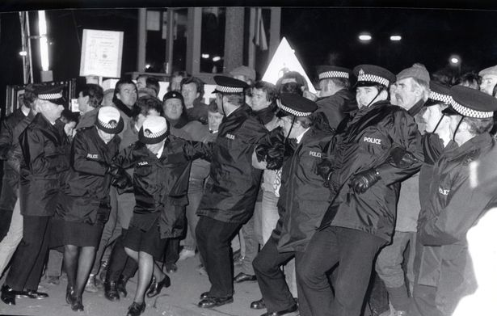
And since then? The 1980s …
1979 Arrival of Thatcher government with a very different mandate
1984 miners’ strike, Strathclyde Region gave money to striking miners’ families under Section 12
1988 Griffiths Report – promoted mixed economy of care through splitting ‘purchaser/provider’ roles
1989 Paper 30 CQSW
Police hold back pickets at Bilston Glen colliery (Daily Record)
www.socialwork.ed.ac.uk/centenary

Slide 10
And 1990s onwards
Orkney 1991
New Labour, modernising & managerialism, mid 1990s
Local government reorganisation 1996
Devolution for Scotland 1998 – social work, health & housing is devolved; social security remains in UK
SSSC created 2001; new requirements for degree in SW 2002, registration & regulation of the workforce 2003
Review of sw in 2004, published in 2006 as Changing Lives
  reaffirmed sw as generic profession, setting out ‘reserved functions of a social worker’
World financial crisis 2007-8; austerity measures hit public spending 2008 onwards
Christie Commission 2011
Scottish referendum on independence 2014
www.socialwork.ed.ac.uk/centenary

Slide 11
Two very different world views emerge
Optimistic about social progress, idealistic about change
Collectivist
Social welfare
Parental rights
Paternalistic
Public services, state is best to provide; rest will be superseded
Equal access
Universal services for all
Generic
Community development
Pessimistic, realistic; ‘nothing works’ mentality; poverty is always with us
Individualist
Social justice
Parental responsibilities, children’s rights
Personalised, person-centred
Roll back the state, reduce costs, mixed economy of care
Individual choice
Targeted provision for the most needy
Specialist
Autonomous citizens
VS
www.socialwork.ed.ac.uk/centenary

Slide 12
And so what’s the long-term impact been??
There’s not a lot left of the SW(S) Act today!
And yet, some continuities
  Scottish solutions still to the fore
  Partnership still between policy, practice & academic communities, and now also service users
  LAs still promoting social welfare
  Public is largely supportive of social work
  Still working on social work’s identity & confidence
What can we do to keep the 1960s aspirations alive – to be a unified profession that plays a major role in renewing communities and transforming society??
Over to you!
www.socialwork.ed.ac.uk/centenary

Slide 13
Key resources
Timeline on www.socialwork.ed.ac.uk/centenary
BASW Scottish Committee (1988) The Promotion of Social Welfare. A promise fulfilled?, Rostrum Supplement, Edinburgh: BASW.
Brodie, I. Nottingham, C. and Plunkett, S. (2008) ‘A tale of two reports: Social work in Scotland from Social Work and the Community (1996) to Changing Lives’ (2006) British Journal of Social Work, 38: 697-715.
Cree, V.E. and Smith, M. (eds) (2018) Social Work in a Changing Scotland, London: Routledge.
Guthrie, T. (2011) Social Work Law in Scotland, Third edition, London: Bloomsbury Professional.
Murphy, J. (1992) British Social Services. The Scottish Dimension, Edinburgh: Scottish Academic Press.
SHHD/SED Kilbrandon Report (1964) Children and Young Persons Scotland, Report of Interdepartmental Committee, Cmnd. 2306.
SED/SHHD (1966) Social Work and the Community White Paper, Cmnd. 3065.

